Slide 1
The Rhodes Scholarship

Slide 2
What is the Rhodes Scholarship?
The Presentation
How to apply?
Mythbusting the Rhodes Scholarship
The Rhodes Scholar Experience

Slide 3
What is the Rhodes Scholarship?
The Rhodes Scholarship is a fully funded postgraduate award which enables young people from around the world, to study at the
University of Oxford.

Slide 4
What do you study at the University of Oxford?
You can study loads of different things! Here are just a few examples...
Environmental Change and Management
Musculoskeletal Sciences
Computer Science
Historical Studies
Geography and the Environment
Fine Art
Literature and Arts
International Development
Biodiversity, Conservation and Management
Cuneiform Studies
Chemistry
African Studies
Law
Economics
Music Composition
Astrophysics
www.ox.ac.uk/admissions/graduate/courses

Slide 5
Rhodes House
It's where the Registrar, the Dean and the Warden are based!
Unlike other Oxford University Students you'll have Rhodes House...
Rhodes House hosts talks, seminars and forums.
There are study spaces, libraries and social events where you will meet other Rhodies.
My first year at Oxford has been a whirlwind of sunshine, rain, wind and snow...In retrospect I can say that I enjoyed exam season, it really brought me closer to my community here at Oxford and made me call Rhodes House home as I spent most of my days in Roseberry studying, napping and procrastinating.
Maitha AlMemari (UAE & University 2018)

Slide 6
Academic achievement and excellence.
What do we look for in a Rhodes Scholar?
Ambition for impact, clarity of purpose, and intrinsic motivation. A commitment to make a difference for good in the world.
The courage and skills required to lead with a wider desire for public good.

Slide 7
Are you Eligible?
Each applicant must fulfil the citizenship and residency requirements of the Rhodes constituency for which they are applying.
Age limits vary between constituencies, ranging between 19 up to a maximum of 27 years.
You must have completed, or be in the processing of completing, an undergraduate
degree with a GPA of 3.7 out of 4 or higher, or the equivalent academic level in your country.

Slide 8
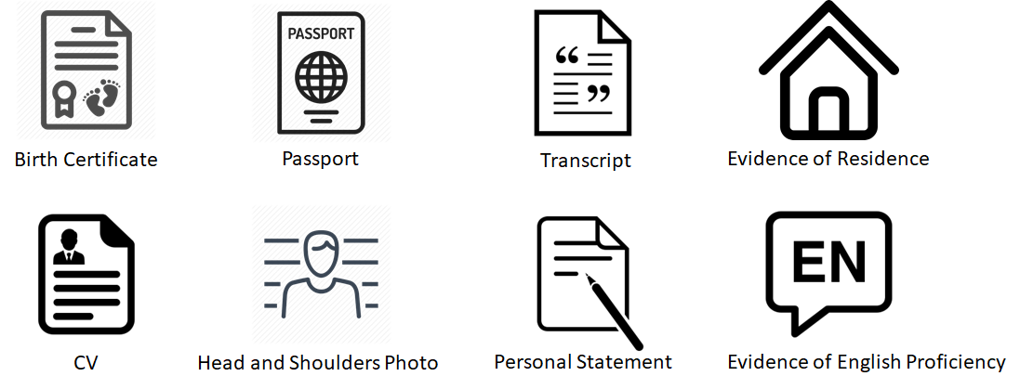
What do you need?

Slide 9
The Application Process
Application Opening and Closing
Rhodes Interview and Selection
Oxford Application
Arrive in Oxford!
June - September
October - December
January - March
September

Slide 10
Myth Number One
We welcome applications from talented young persons of diverse backgrounds. Selection is made without regard to gender, gender identity, marital status, sexual orientation, race, ethnic origin, colour, religion, social background, caste, or disability.
I’m not the type of person who can win a Rhodes Scholarship.

Slide 11
Myth Number Two
Academic ability is important as you will need to be able to gain entry to the
University of Oxford; however, equally important is your commitment to serve
others.
I have to be top of my class.

Slide 12
Myth Number Three
I can’t apply because my country is not listed as a Rhodes constituency.
We now offer two Global Scholarships for anyone who does not meet the existing selection criteria for the current Rhodes constituencies.

Slide 13
Myth Number Four
As long as you demonstrate that you have worked to improve the lives of others, is
what counts. It can be done in a multitude of ways in your own neighbourhood. You
will also need to be able to talk in the interview about what you hope to do in
the future.
You have to have done months of volunteer work abroad or started your
own NGO.

Slide 14
Myth Number Five
Today’s Rhodes Scholars include Presidents and Prime Ministers, but also medical
researchers, social workers, artists, journalists, lawyers, teachers, activists, poets, doctors
and many more!
Most
Scholars end up as political leaders.

Slide 15
What is the Rhodes experience like?
"I am exceedingly grateful for the opportunity to study at the University of Oxford. I have made many lovely friends amongst the Rhodes community, as well as in my classes and college."
Jean Balchin
(New Zealand & Trinity 2018)
"Rhodes House has afforded me the opportunity to make lifelong friendships with great minds from diverse backgrounds, from whom I have learned so much."
Emmanuelle Dankwa (West Africa & St Peter's 2018)
"The thing I enjoyed the most about Rhodes House was how so many Scholars from so many different backgrounds are put together, forcing us to embrace our differences and learn from each other's cultures."
Xilin Jiang (China & University 2017)
"I am grateful to be a part of the Rhodes community because it is an intellectually stimulating environment that helps me better understand political and social issues outside of my discipline."
Ian Sander (Prairies and St Peter's 2018)

Slide 16
What makes the Rhodes Scholarship Unique?
Welcome Week introduces you to Oxford, Rhodes House, and other Rhodes Scholars! With fun social activities, as well as interesting workshops, it's designed to make you feel at home in your new city.
Rhodes Scholar Christmas Dinner, Going Down & Coming Up Dinner, Rhodes Ball.
You join a warm and inclusive community of Rhodes Scholars from across the world. "Once a Rhodes Scholar, always a Rhodes Scholar."
You take part in retreats that will help you develop and work on your character, service and leadership skills.
Attending Scholar Talks and Forums at Rhodes House, where you can meet and listen to world leading experts.
Find out more at...
WWW.RHODESHOUSE.OX.AC.UK/APPLY
Yoga and Mindfulness Courses.

Slide 18
WWW.RHODESHOUSE.OX.AC.UK/APPLY

